Slide 1



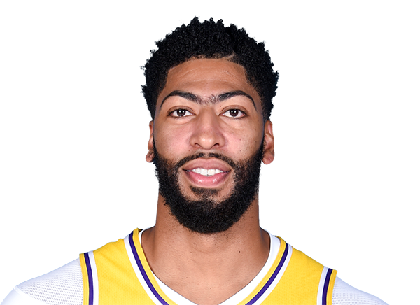
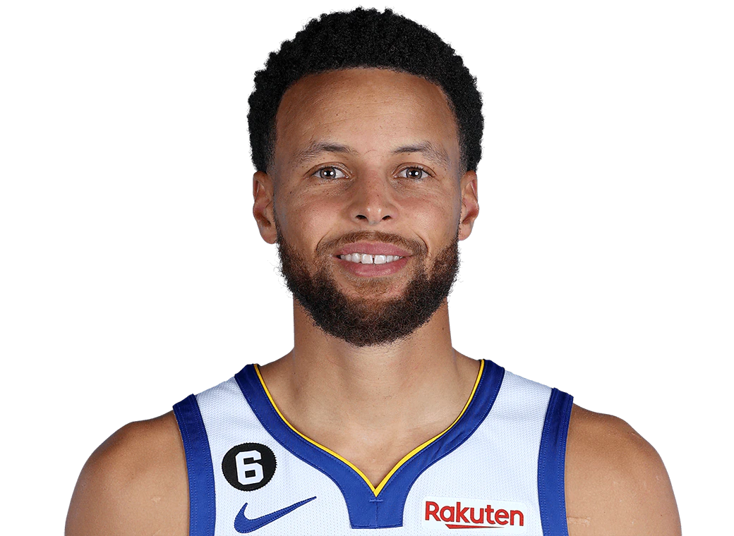

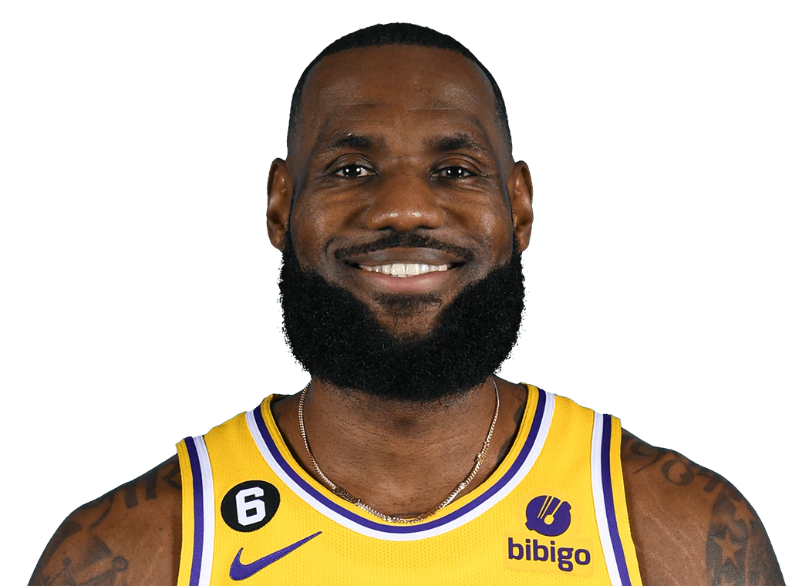
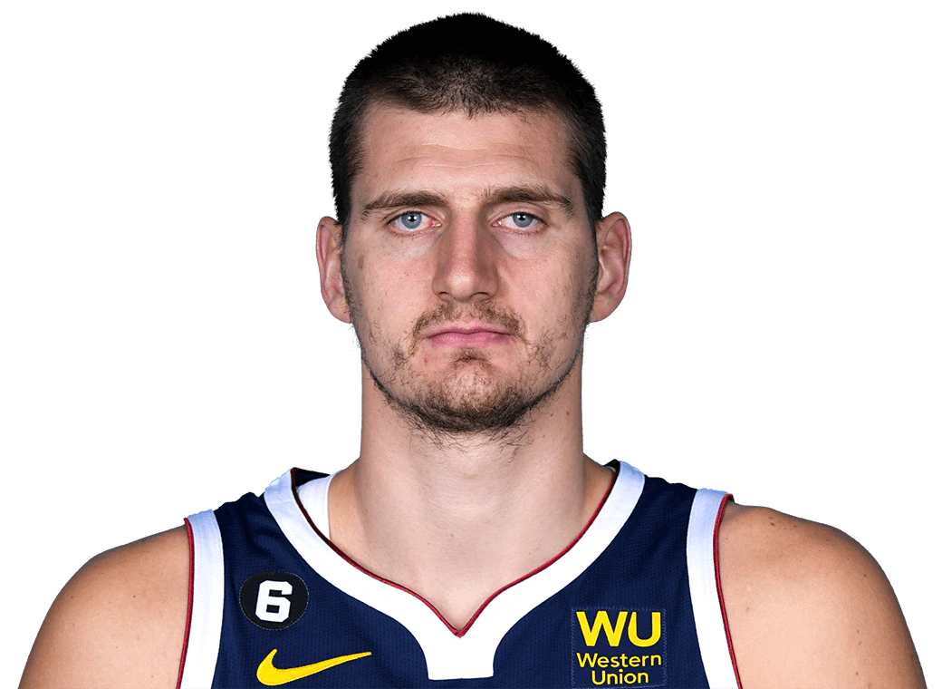
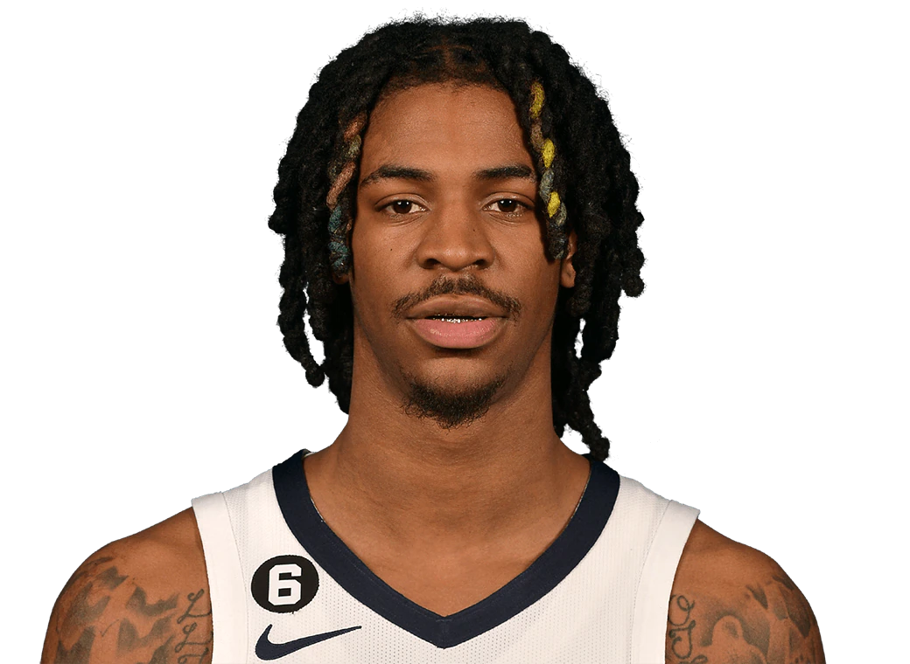
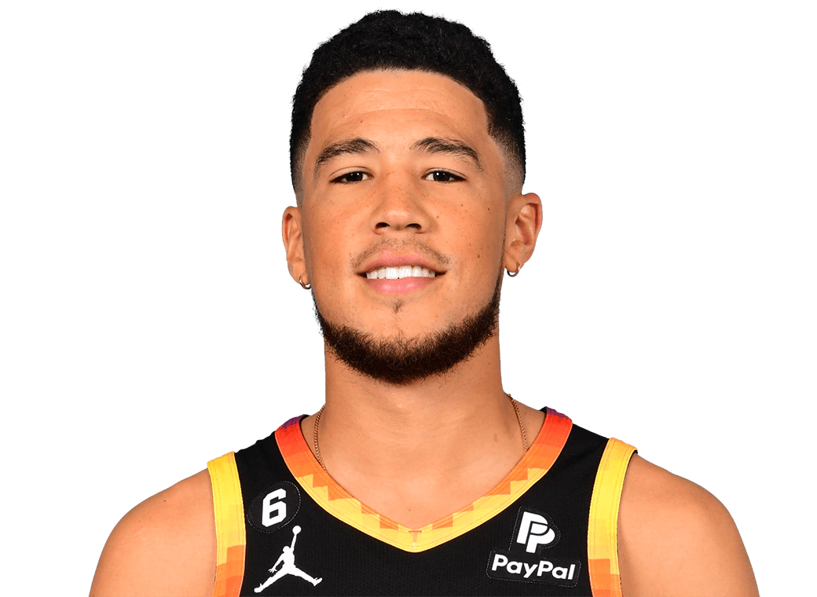
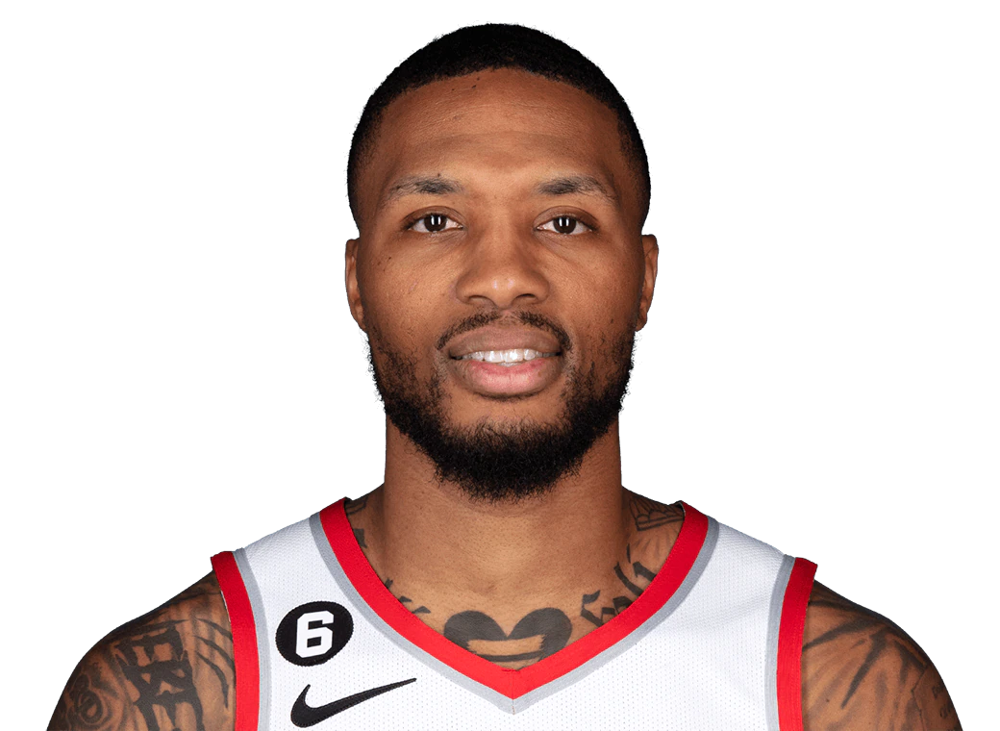
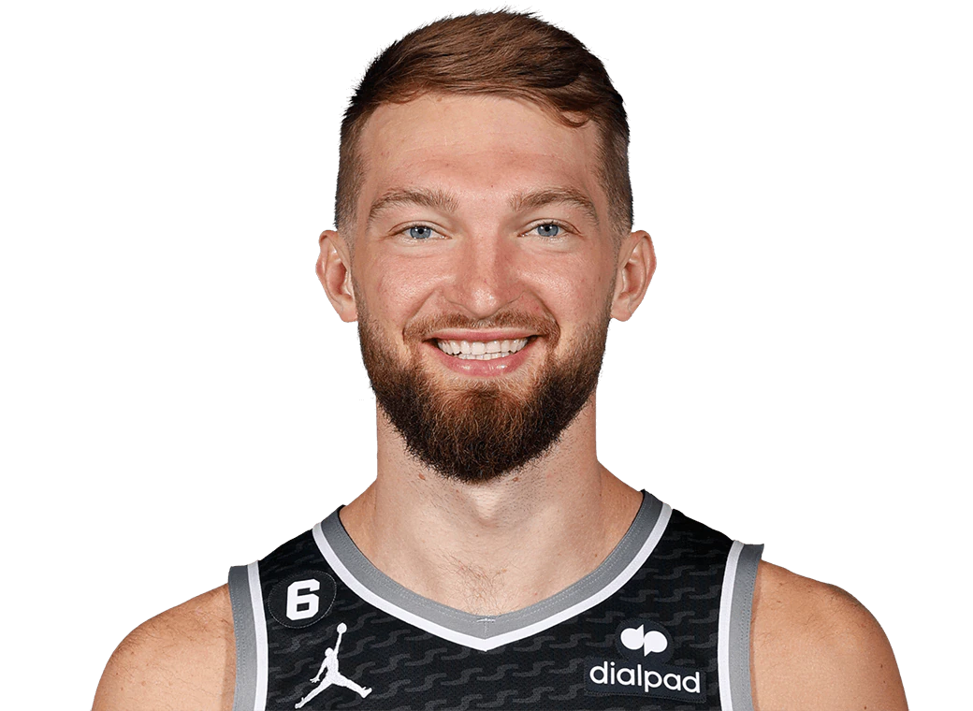
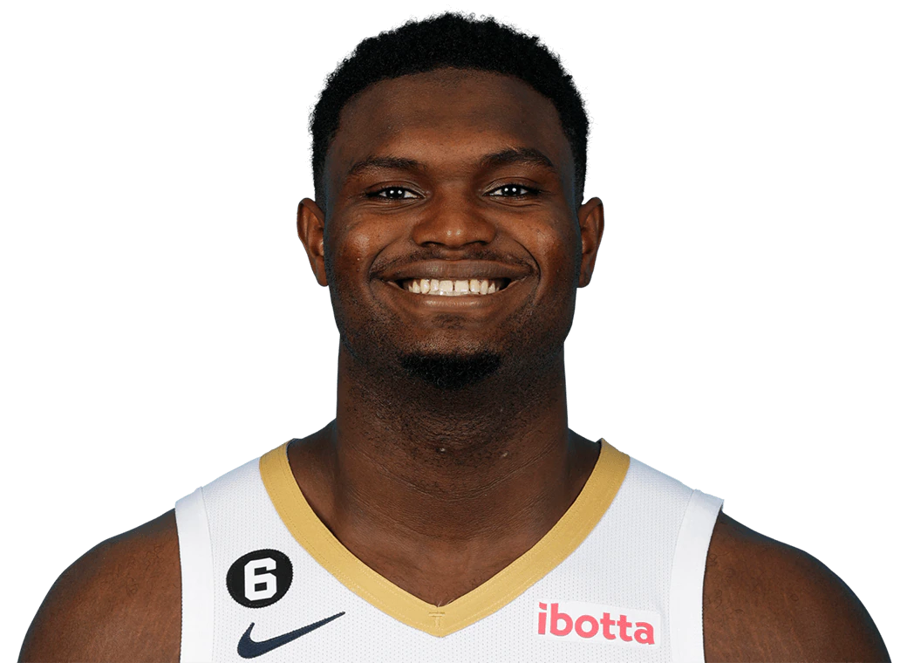
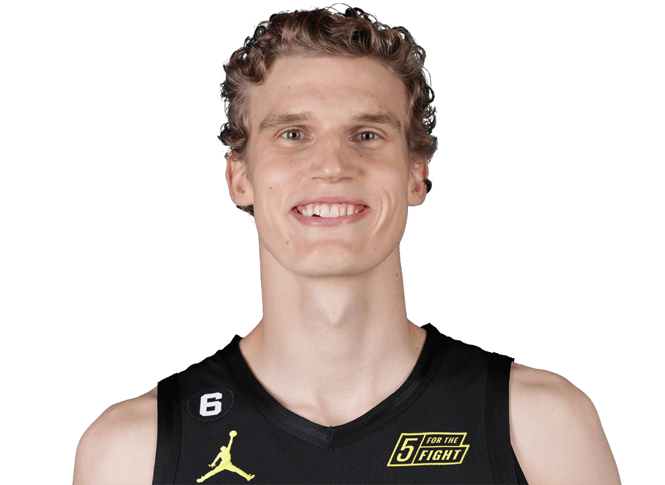
2023 NBA Western Conference All-Star Predictions
Player (Guard/Frontcourt): All-Star Probability
1 Luka Doncic (G): 99.9%
Anthony Davis (99.9%) 2
3 Steph Curry (99.98%)
Shai Gilgeous-Alexander (99.7%) 4
5 LeBron James (99.2%)
Nikola Jokić (99.0%) 6
7 Ja Morant (98.8%)
Devin Booker (96.3%) 8
9 Damian Lillard (88.2%)
Damontas Sabonis (77.2%) 10
11 Zion Williamson (69.2%)
Lauri Markkanen (8.5%) 12

